Slide 1

Networking Concepts Template
A Hyperlink Presentation
By: Darren, Jasjot, Noor, Raakin

Slide 2
Table of Contents
Some Useful Documentation (Darren)
Some Basic Concepts (Darren)
Web Servers & Web Pages (Noor)
Domain Names & IP Addresses (Raakin)
Mail Servers & Other Types of Servers(Jasjot)
Network Routing & ISPs (Noor and Jasjot)
Local Area & Wide Area Networks & VPNs (Raakin)

Slide 3


1) Some Useful Documentation
How to use Hyperlinks in PowerPoint
You are able link key phrases to other slides like this
Home

Slide 4
Welcome You have Used A Hyperlink

Slide 5
How to use/create a Hyperlink
How to use
If a hyperlink is set up correctly, all you need is to click the linked word.
How to create
Highlight word you want to link
Link whatever link or slide you want then press apply
Congratulation, you have created a hyperlink

Slide 6
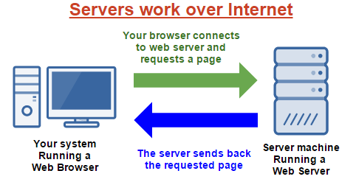

2) Some Basic Concepts
Section Topics
Client Server Model
Peer-To-Peer Model
Hyperlinks
Packets & Data
Firewalls
Basic Concepts
Home

Slide 7
2.1) Client Server Model
Explain the Client Server Model
What is the Client
Client–server model is a distributed application structure that partitions tasks or workloads between the providers of a resource or service, called servers, and service requesters, called clients.
What is the Server
The server is usually called the content server. This server usually contains all the information. The hyperlink allows the person to link the object/word to the information stored inside the server. Without the server, the hyperlink would not be able to link to anything.
Provide an example of an application that uses the Client Server Model
Login Credentials
Basic Concepts
Home

Slide 8
2.2) Peer-To-Peer Model
Explain the Peer-To-Peer Model
What is a Peer
A peer is a node that the peer to peer model uses. The model equally separates the workload between the different nodes.
How is it different from a Client Server Model
Instead of relying on one server, this model relies on multiple peers/nodes.
Provide an example of an application that uses the Peer-To-Peer Model
File Sharing Software Napster
Basic Concepts
Home

Slide 9
2.3) Hyperlinks
What is a Hyperlink?
A link between a hypertext file to connects to a different location or file
How are Hyperlink related to Web Pages?
Simply browsing the internet, uses hyperlink. When searching and clicking on search results, you use a hyperlink. Click on the highlighted word which redirects you to the different location/ page.
How are Hyperlinks related to this PowerPoint document?
Navigation
Basic Concepts
Home

Slide 10
2.4) Packets & Data
What is a Data Packet? Unit of data that is compressed into a single package that will travel along a given network path.
What happens to a message (or data) when it is sent across the Internet?
When someone is messaged, it first goes to the control channel where it is stored. Then the control channel sends the message to the phone it was supposed to be sent to.
Basic Concepts
Home

Slide 11
2.5) Firewalls
What is a Firewall?
Part of the computer to prevent unauthorized user from access your computer.
How does a Firewall protect your computer?
Unauthorized programs could possibly attack your computer and cause harm. The firewall prevents this to its best ability.
How does a Firewall protect remote servers?
Private servers have firewalls which are only bypassable with a password. Without a password, there is no other way in except hack through the firewall. This prevents secrets from getting out or become known.
Basic Concepts
Home

Slide 12
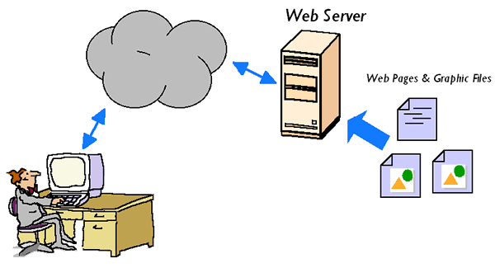

3) Web Servers & Web Pages
Section Topics
HTML
Browsing A Web Page
Web Client Hardware & Software
Web Server Hardware & Software
Web Servers
Home

Slide 13


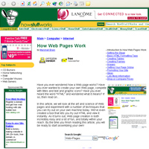
3.1) HTML & Web Pages
What does HTML stand for?
HTML stands for Hypertext Markup Language. Which is a standardized system for tagging text files to achieve font, color, graphic, and hyperlink effects on World Wide Web pages.
How is HTML related to Web Pages?
The three main technologies used to create web pages (HTML, CSS and JavaScript) each do different special jobs. So the way HTML is related to web pages is that it performs the job of marking the contents up into different structural types, like paragraphs, blocks, lists, images, tables, forms, comments etc.
What are some examples of HTML tags used in Web Pages?
<HTML> -> tells your web browser that a page with HTML is coming up. The opening tag is always placed at the beginning of your document, and the closing tag is placed at the very end.
<HEAD> -> Includes the title of your web page, any search terms, and other stuff we won't get into here. The opening is placed right after the initial HTML tag, and the closing is right away after any HEAD items.
<TITLE> Included in the HEAD part of the document. The text you put here is what shows up on the top of the browser.
What are some other languages used in Web Pages?
The most common programming languages on the Web include JavaScript, Cascading Style Sheets and PHP: Hypertext Preprocessor. Some are used in conjunction with each other while some can be used almost entirely separate from the other languages to create an interactive or static website.

Slide 14
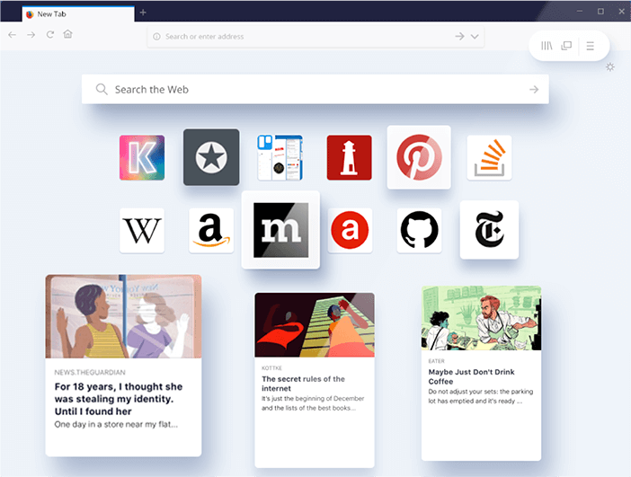
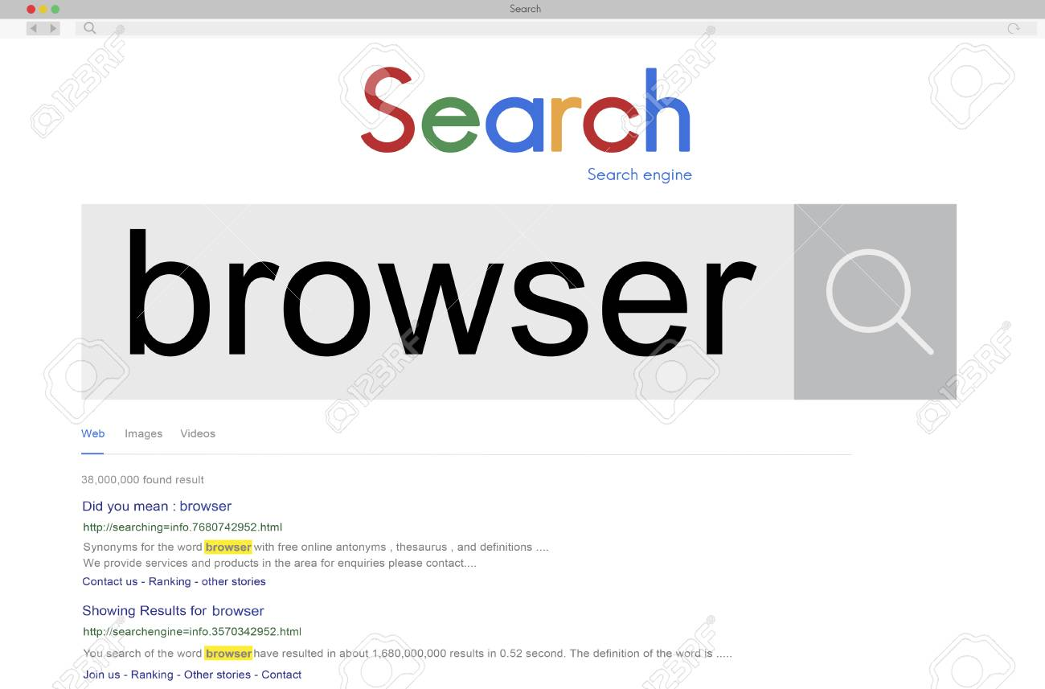
3.2) Browsing a Web Page
What happens when you browse a web page?
What are the main steps?
You enter a URL into a web browser
The browser looks up the IP address for the domain name via DNS
The browser sends a HTTP request to the server
The server sends back a HTTP response
The browser begins rendering the HTML
The browser sends requests for additional objects embedded in HTML (images, css, JavaScript) and repeats steps 3-5.
Once the page is loaded, the browser sends further async requests as needed.
Web Servers
Home

Slide 15
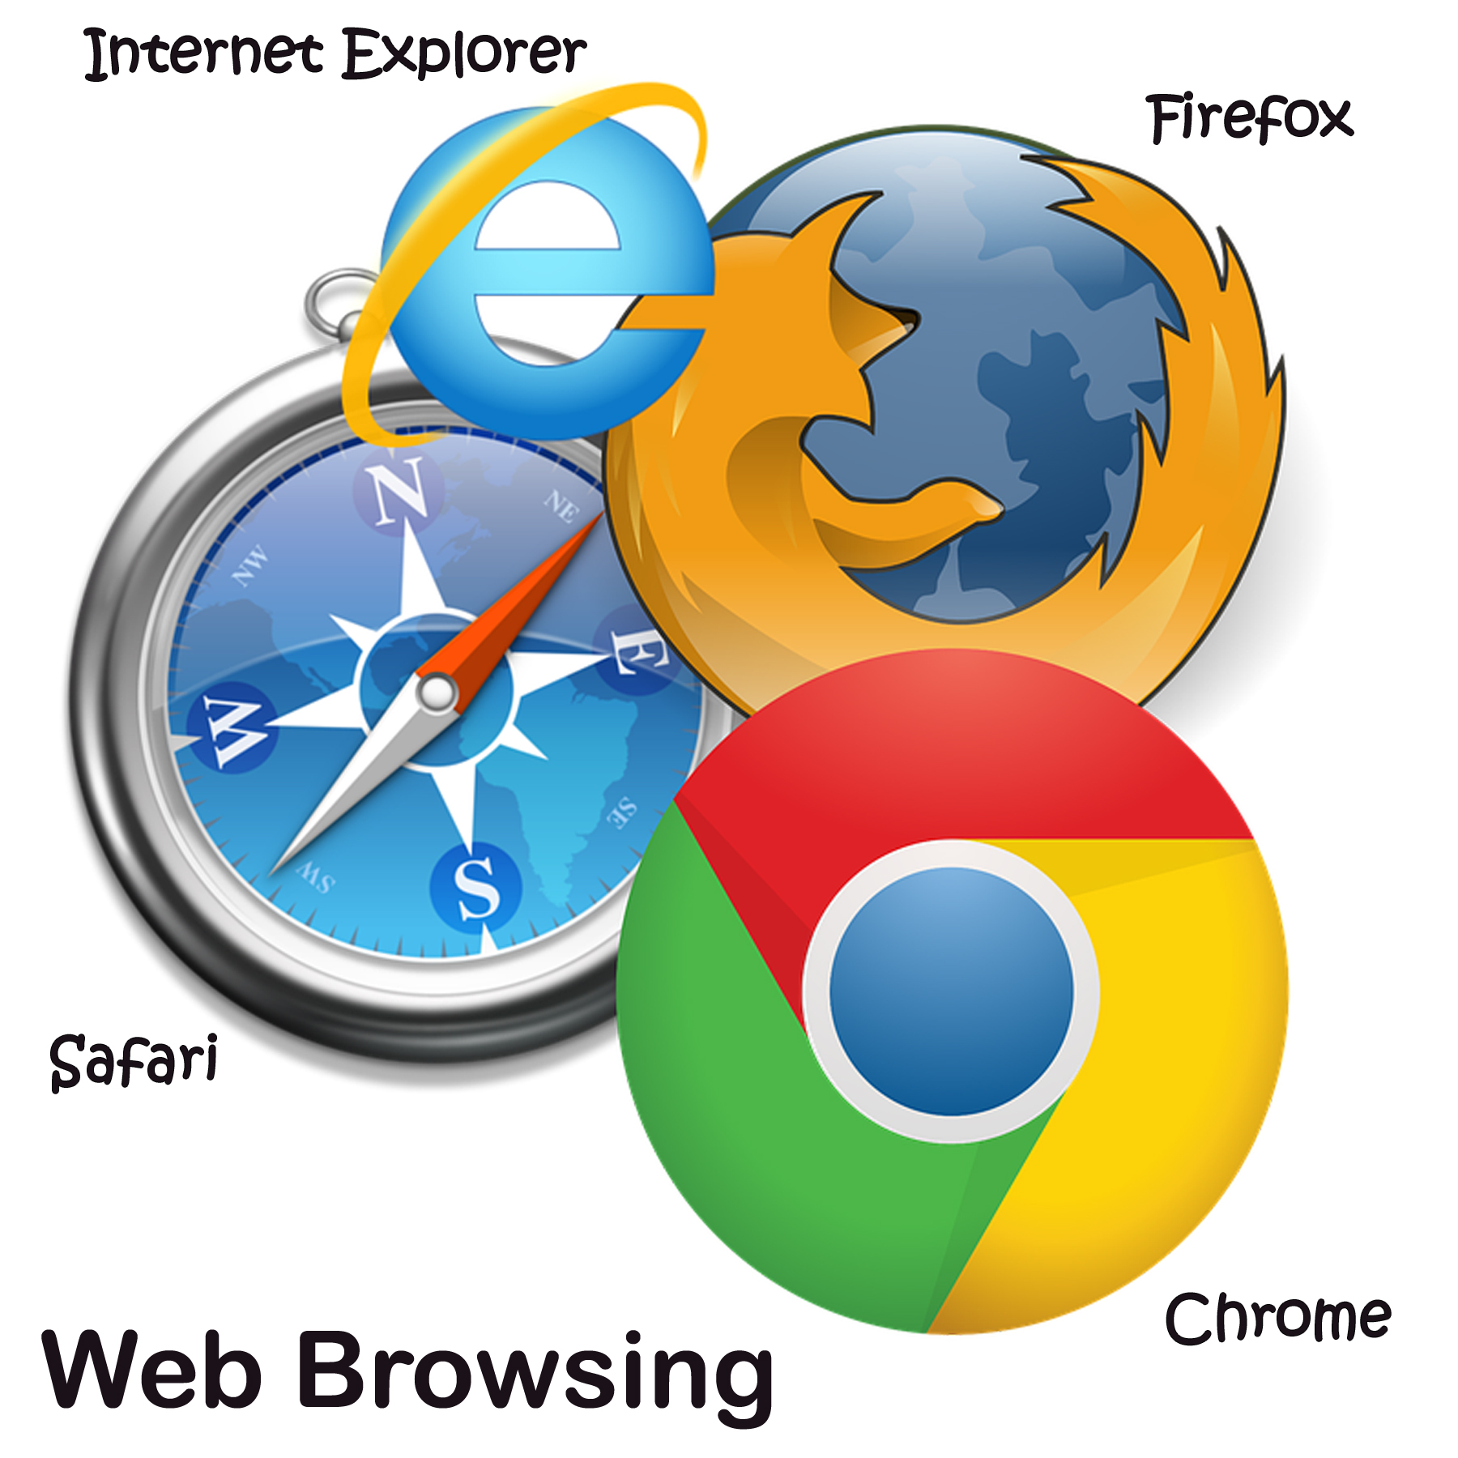
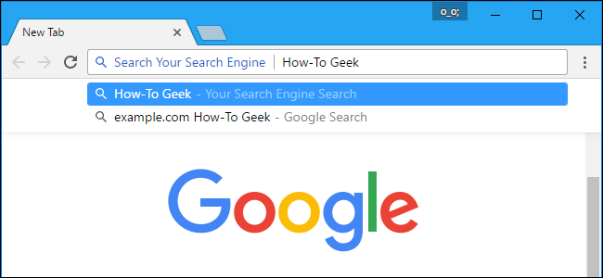
3.3) Web Client Hardware & Software
What does a Web Browser do?
A web browser, or simply "browser," is an application used to access and view websites. The primary function of a web browser is to render HTML, the code used to design or "mark up" web pages.
What are some common web browsers?
How are they different?
Common web browsers include Microsoft Internet Explorer, Google Chrome, Mozilla Firefox, and Apple Safari.
Internet Explorer is the default browser that comes installed on most, it has a very sophisticated tab management system, which is very helpful for people who like to have several pages open at once.
Google Chrome is quickly becoming a very popular option known for its speed and simplicity.
Mozilla Firefox is known for its vast array of add-ons that add to the web-browsing experience.
Safari is the default web browser installed on Macs, and is known for its simple and non-flashy approach.
What are some other types of Web Clients?
Is there any special Hardware or Software required to run a web client?
Web Servers
Home

Slide 16
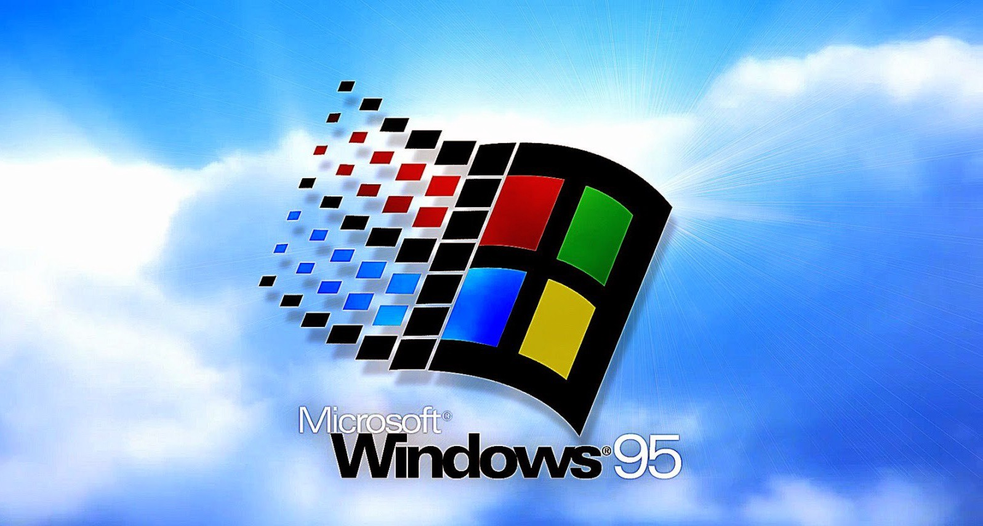
3.4) Web Server Hardware & Software
What does a Web Server do?
The primary function of a web server is to store, process and deliver web pages to clients. The communication between client and server takes place using the Hypertext Transfer Protocol (HTTP).
Where are Web Servers located in the Network / Internet?
Generally websites are hosted on a set of servers called a server farm which may be located in one or multiple different data centres. Farms are used to ensure high availability and load balancing of an IT system ( say a website). Load balancers are used to distribute the load among the servers in the farm.
What special Software is needed for a Web Server
In order to set up a Web server, you need a dedicated computer (PC or Macintosh) running Windows/95, Windows/NT, or Linux or a Macintosh computer running MacOS. You also need a direct Internet connection and TCP/IP software. You can download shareware HTTP software for these platforms and operate your own Web server.
What special Hardware is needed for a Web Server
Most web servers need CPUs, RAM, storage, and network connections.
Web Servers
Home

Slide 17
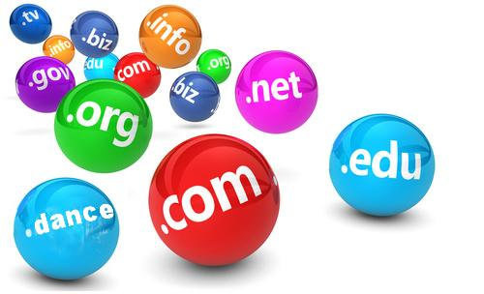

4) Domain Names & IP Addresses
Section Topics
What is a Domain Name?
What is an IP Address?
Controls the assignment of Names & Addresses?
Domain Names
Home

Slide 18
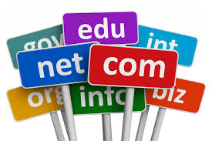
4.1) What is a Domain Name?
What is a Domain Name?
A domain name is your website name. A domain name is the address where Internet users can access your website. A domain name is used for finding and identifying computers on the Internet. Computers use IP addresses, which are a series of number. However, it is difficult for humans to remember strings of numbers. Because of this, domain names were developed and used to identify entities on the Internet rather than using IP addresses.
Domain Name System (DNS) is a protocol within the set of standards for how computers exchange data on the internet and on many private networks, known as the TCP/IP protocol suite. The main purpose of DNS is that it helps convert domain names like websites.
How are Domain Names related to Web Pages?
Domain names are usually used to identify one or more IP addresses. Domain names are used in URLs to identify particular Web Pages.
How does my computer find and use Domain Names?
Computers and other network devices on the internet use an IP address to route your request to the site you’re trying to reach. This is similar to dialing a phone number
Domain Names
Home

Slide 19
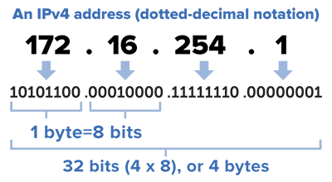
4.2) What is an IP Address?
What is an IP Address?
An IP address, or simply an "IP," is a unique address that identifies a device on the Internet or a local network. It allows a system to be recognized by other systems connected via the Internet protocol. There are two primary types of IP address formats used today — IPv4 and IPv6.
What is the difference between IPv4 and IPv6?
The main difference between them is that the IPv4 is a 32-bit numeric address and is written in decimal as four numbers separated by periods. IPv6 addresses however are 128-bit. The addresses are written in hexadecimal and separated by colons.
How does my computer convert a Domain Name to an IP Address?
DNS (Domain Name System) is the protocol that converts IP addresses to friendly domain names. It also does the reverse and transfers friendly domain names to IP addresses. DNS servers are the main standard of the internet. If the DNS does not exist, you would not be able to view a web page using the domain name and you will need to remember IP addresses to open a website.
Home

Slide 20
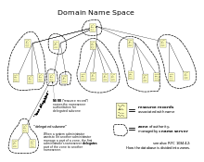
4.3) Who Controls Domain Names?
Who Owns and Controls Domain Names and IP Addresses?
Today, the Internet Corporation for Assigned Names and Numbers (ICANN) manages the top-level development and architecture of the Internet domain namespace. It authorizes domain name registrars, through which domain names may be registered and reassigned.
How can I register a Domain Name for my own use?
A domain name involves registering the name you want with an organization and this organization that I talked about (ICANN) through a domain name registrar. In order to have your own type of domain name, you will most likely have to pay around $10 USD to $35 USD for that particular name. This will give you the right to the name for a year then you will have to renew it for the same amount. However, there are some web hosts will register it and pay for the name for free.
Domain Names
Home

Slide 21
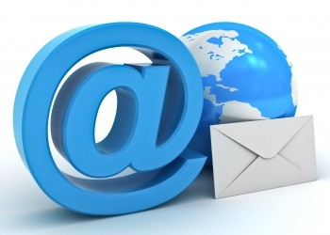

5) Mail & Other Servers
Section Topics
Mail Servers
A mail server (or email server) is a computer system that sends and receives email. Mail servers send and receive email using standard email protocols.
File Servers
A file server is a computer attached to a network that provides a location for shared disk access, which is shared storage of computer files that can be accessed by the workstations that are able to reach the computer that shares the access through a computer network
Database Servers
A database server is a server which houses a database application that provides database services to other computer programs or to computers.
Other Types of Servers
Web Server - A Web Server serves static content to a Web browser by loading a file from a disk and serving it across the network to a user's Web browser.
Application Server - Application servers occupy a large chunk of computing territory between database servers and the end user, and they often connect the two.
FTP Server - File Transfer Protocol makes it possible to move one or more files securely between computers while providing file security and organization as well as transfer control.
Servers
Home

Slide 22
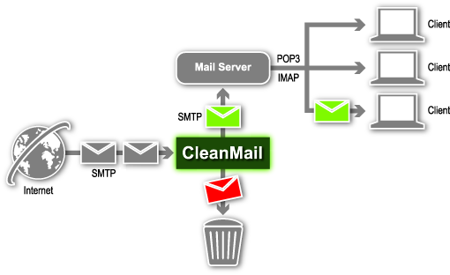

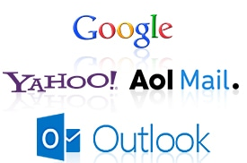
5.1) Mail Servers
Downloaded Mail
What is SMTP / POP3?
SMTP and POP3 are the two protocols which take care of the email flow (send and receive respectively) on the internet. SMTP (“Simple Mail Transfer Protocol”) is used for sending and delivering from a client to a server: it’s the outgoing server. On the contrary, POP (“Post Office Protocol”) allows the user to pick up the message and download it into his own inbox: it’s the incoming server.
What are some common Mail Clients
An email client, or mail client is a computer program used to access and manage a user's email. Some very popular and common mail clients are Microsoft Outlook, Mail and Calendar, eM Client, Mailbird Pro, and TouchMail. A mail client is
What are some advantages of downloaded mail?
Once downloaded to a device or computer, we can read and see the mail afterwards, even with no internet connection.
Web Based Mail
What are some common Browser Based Mail Services
Browser Based Mail is any email client implemented as a web application running on a web server. Examples of webmail software are Roundcube and SquirrelMail. Examples of webmail providers are AOL Mail, Gmail, Outlook.com/Hotmail.com, Rackspace Email, Yahoo! Mail and IceWarp Mail Server.
What are some advantages of browser based mail?
Convenience - If you travel frequently and work from remote locations, this can be the most crucial advantage of webmail. You can access and use it from any computer with an Internet connection. All your messages will be accessible no matter where you access your account.
Cost - Basic webmail services from the big providers are usually free.
Mail Servers
Where is mail stored in the Internet?
Mail can be stored on the client or on the server side, or in both places.
How is mail delivered across the Internet?
In both cases, whether the message is created by an email client or by an automated system, it is specially formatted to be transmitted over the Internet using a standard called “Simple Mail Transfer Protocol” (SMTP). Then the receiving server accepts the message so that it can be delivered to the recipient.
What special Hardware & Software is required for a mail server?
Software: In order to set up a Web server, you need a dedicated computer (PC or Macintosh) running Windows/95, Windows/NT, or Linux or a Macintosh computer running MacOS. You also need a direct Internet connection and TCP/IP software. You can download shareware HTTP software for these platforms and operate your own Web server.
Hardware: A Processor, RAM, HDD, Microsoft Azure Virtual Machine Configuration is recommended.
Servers
Home

Slide 23
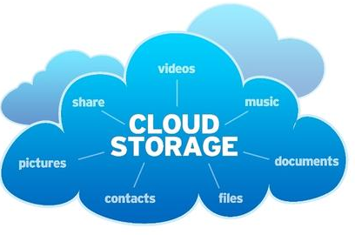
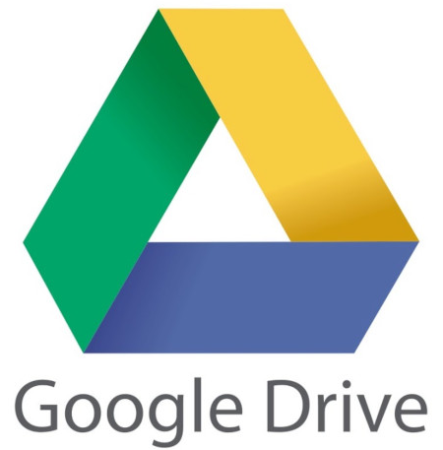
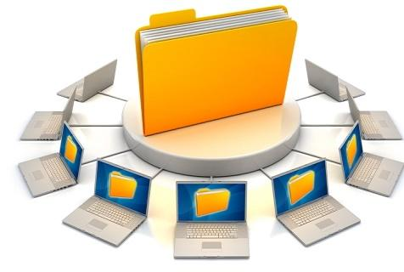
5.2) File Servers
Cloud Based Storage
What are some Cloud Storage Services (applications) ?
Some Cloud Storage Services are IDrive, SugarSync, SpiderOak ONE, Microsoft OneDrive, CertainSafe Digital Safety Deposit Box, Google Drive, Apple iCloud Drive, Box.
What are some advantages of cloud based storage over local storage?
Because local storage means that all files are only stored in one place, local storage leaves your data more vulnerable to physical theft of the device. Responding to the shortcomings of local storage, cloud storage offers greater flexibility, accessibility, and scalability for small business data storage. It is cost-effective, and maintenance is not an issue as cloud storage providers handle all of the upgrades and troubleshoot any issues that arise. Accessibility is also an advantage because data stored on the cloud is easily accessed on any device that has an internet connection.
File Servers
What special Hardware & Software is required for a file server?
Hardware:
64 Bit Processors, Single or Dual CPU, 4 or 8 Core per CPU
Min of 24 GB of RAM or better recommended
Fast SAS/SCSI/raid controller (with fast caching)
Raid 10 configuration, fast SCSI / SAS hard disk drives 15,000 RPM, SSD Drives recommended.
UPS battery to protect file server
Software:
Windows Server 2012 R2 or Higher, Standard/ Enterprise/ Datacenter
Microsoft SQL Server 2014/ 2016 or Higher, Standard/ Enterprise
Servers
Home

Slide 24
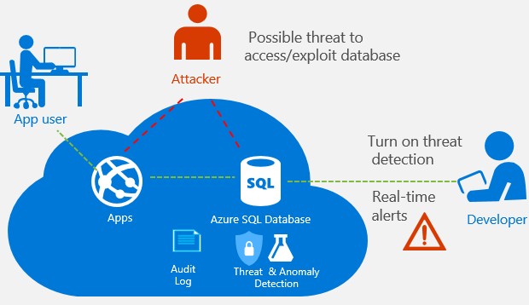
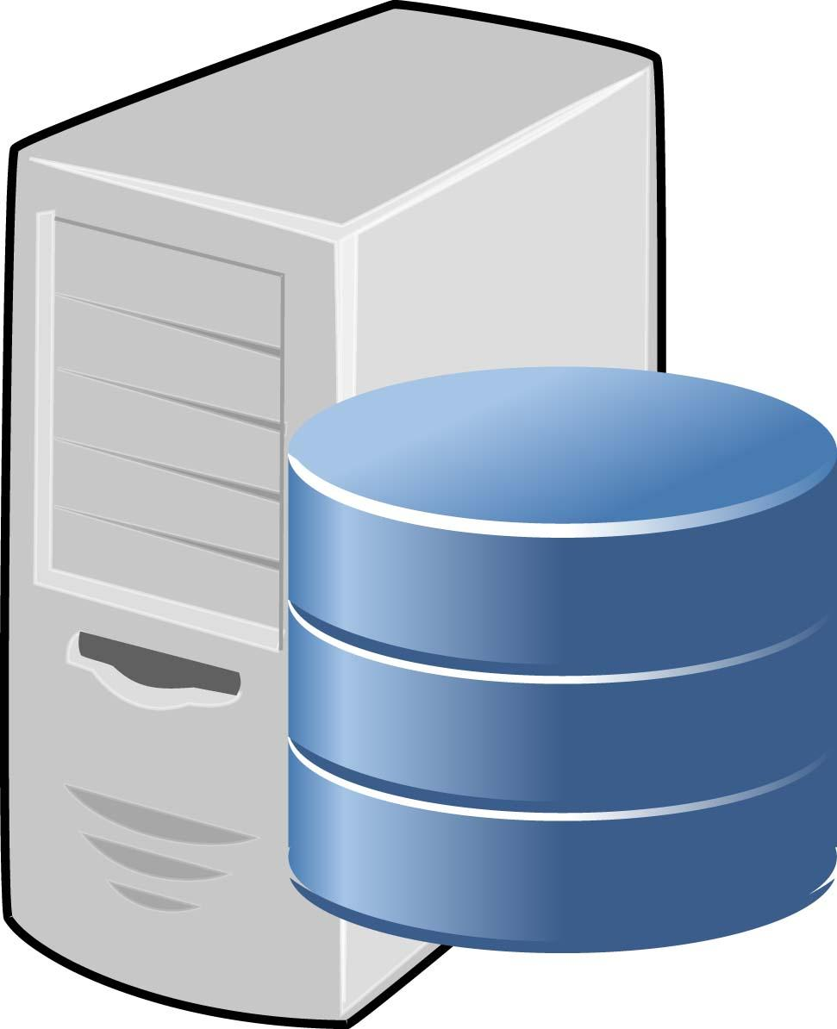

5.3) Database Servers
What is a Database?
A database is an organized collection of data, generally stored and accessed electronically from a computer system.
What is SQL?
SQL is a domain-specific language used in programming and designed for managing data held in a relational database management system, or for stream processing in a relational data stream management system.
What type of information is stored in a database?
Data in a database is primarily stored in database tables, which are organized into columns that dictate the data types stored.
How are databases used and combined with web pages?
One of the most common types of combined web pages is the database driven type. This means that you have a web page that grabs information from a database (the web page is connected to the database by programming,) and inserts that information into the web page each time it is loaded.
Database Servers
What are some common Database products?
Some common and popular Database products are Oracle RDBMS, IBM DB2, Microsoft SQL Server, SAP Sybase ASE, Teradata, ADABAS, MySQL and FileMaker.
What special Hardware & Software is required for a database server?
Hardware:
Minimum 1 GHz processor (dual processor 3 GHz or better is recommended)
Minimum of 2 GB RAM (8GB or better is recommended)
SCSI RAID Disk Array with a minimum of 100 GB free disk space (250 GB or better is recommended).
Software:
Microsoft SQL Server: Versions 2005 or higher (Express Edition or better)
PostgreSQL 9.0 or higher.
Microsoft Azure SQL DB.
Servers
Home

Slide 25
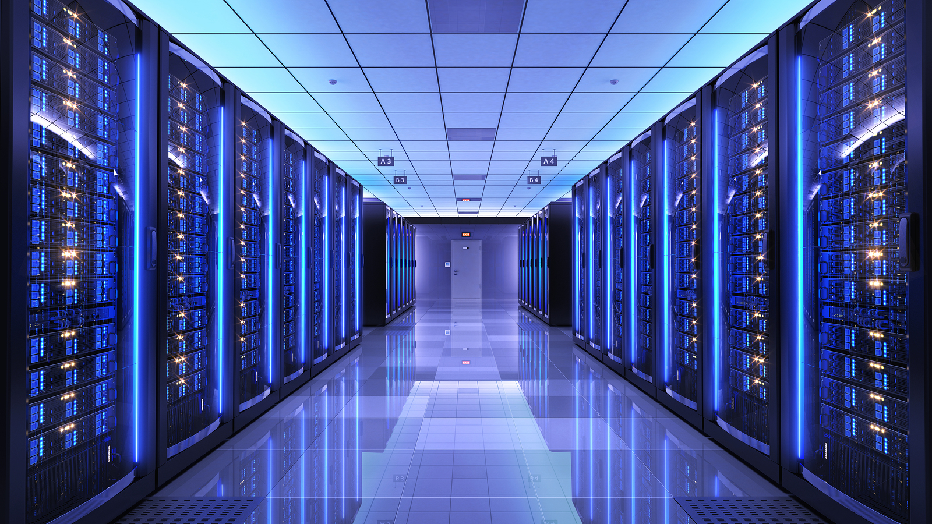
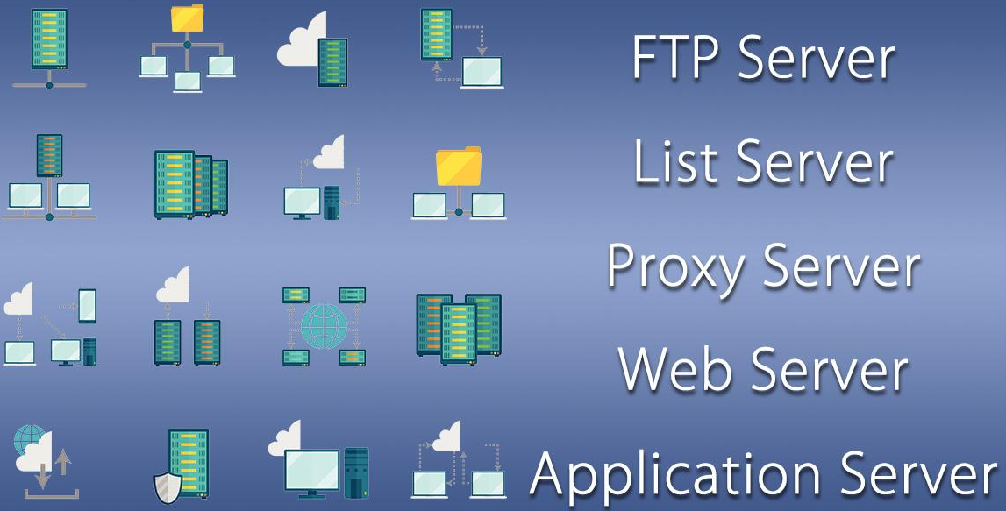
5.4) Other Servers
Describe some other types of internet servers not covered by the slides above.
Collaboration Server - Collaboration software designed to enable users to collaborate, regardless of location, via the Internet or a corporate intranet and to work together in a virtual atmosphere.
List Server - List servers offer a way to better manage mailing lists, whether they be interactive discussions open to the public or one-way lists that deliver announcements, newsletters or advertising.
Web Server - A Web Server serves static content to a Web browser by loading a file from a disk and serving it across the network to a user's Web browser.
Application Server - Application servers occupy a large chunk of computing territory between database servers and the end user, and they often connect the two.
FTP Server - File Transfer Protocol makes it possible to move one or more files securely between computers while providing file security and organization as well as transfer control.
Servers
Home

Slide 26
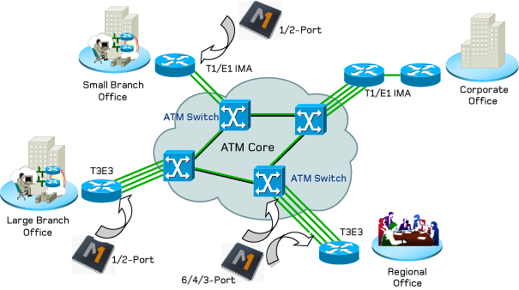

6) Network Routing & ISPs
Section Topics
Internet Service Provider (ISP)
Internet Connection Technologies
Network Routers & Switches
Networks
Home

Slide 27
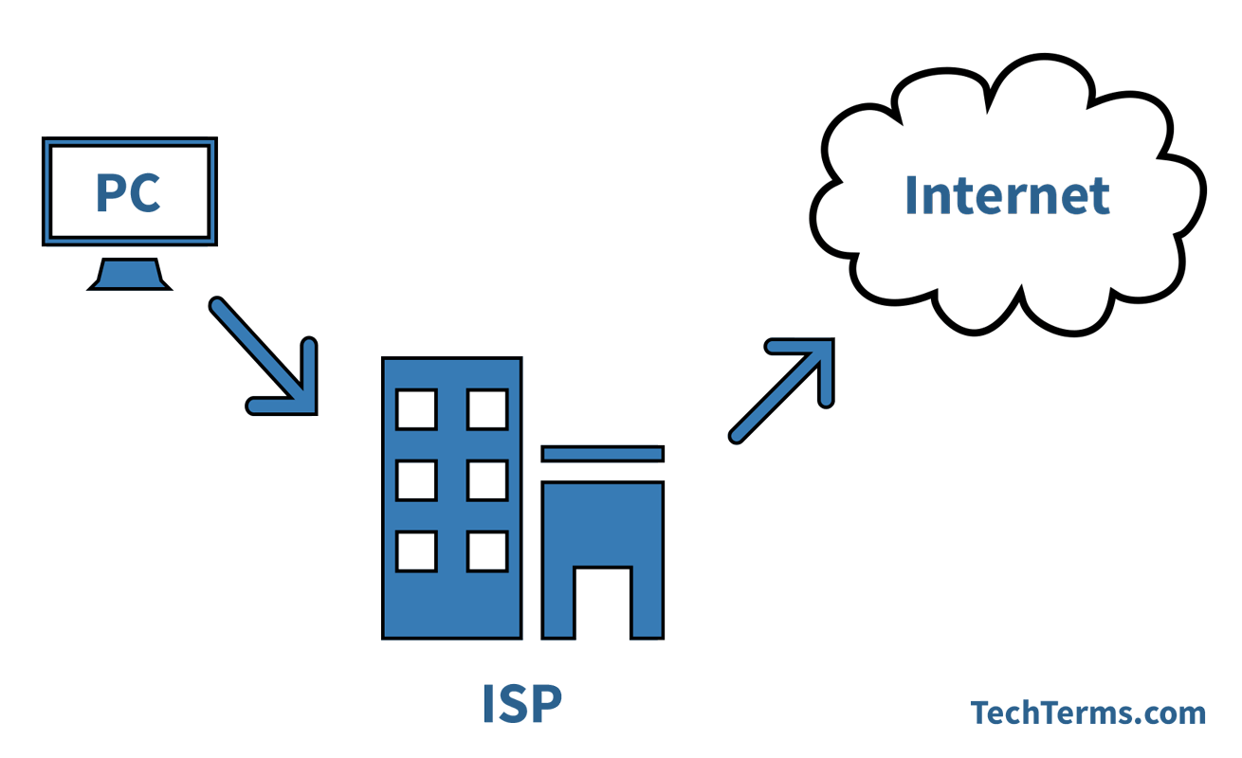


6.1) Internet Service Providers (ISPs) (Noor)
What is an ISP?
An ISP stands for Internet Service Provider and IP address means Internet Protocol Address. Your ISP is how you gain access to the Internet.
What are some common ISPs people use in the Toronto Area?
Dotto-One.
Colosseum Online.
TELUS Store.
Beanfield Metroconnect.
Telus.
Virgin Mobile.
Carry Telecom.
Fast Puppies.
How is an ISP different from a Internet application / service?
The Internet has many important applications. The three most important are e-mail, web browsing, and peer-to-peer services . E-mail, also known as electronic mail, is the most widely used and successful of Internet applications. Whereas an ISP is a company that provides individuals and other companies access to the Internet and other related services such as Web site building and virtual hosting.
Networks
Home

Slide 28

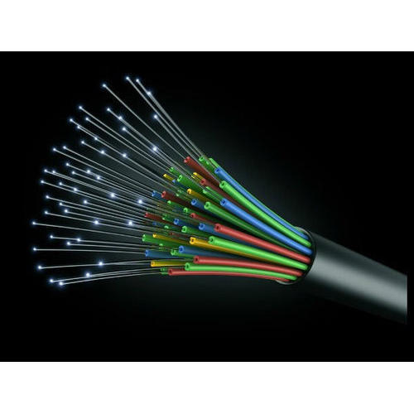
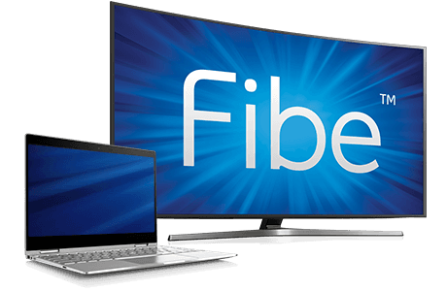
6.2) Internet Connection Technologies (Noor and Jasjot)
Describe some internet connection technologies using telephone lines. (Noor)
Dial-up access.
Multilink dial-up.
Integrated Services Digital Network.
Leased lines.
Cable Internet access.
Digital subscriber line (DSL, ADSL, SDSL, and VDSL)
DSL Rings.
Describe some internet connection technologies using Wi-Fi. (Jasjot)
Xfinity.
Comcast.
HughesNet.
AT&T.
CenturyLink.
Cox.
Frontier.
Spectrum.
Describe some internet connection technologies using fibre optics cables. (Jasjot)
AT&T Fiber
Optimum Fiber
Frontier Fiber
Bell Fibe
EPB Fiber
Networks
Home

Slide 29
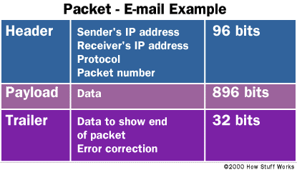
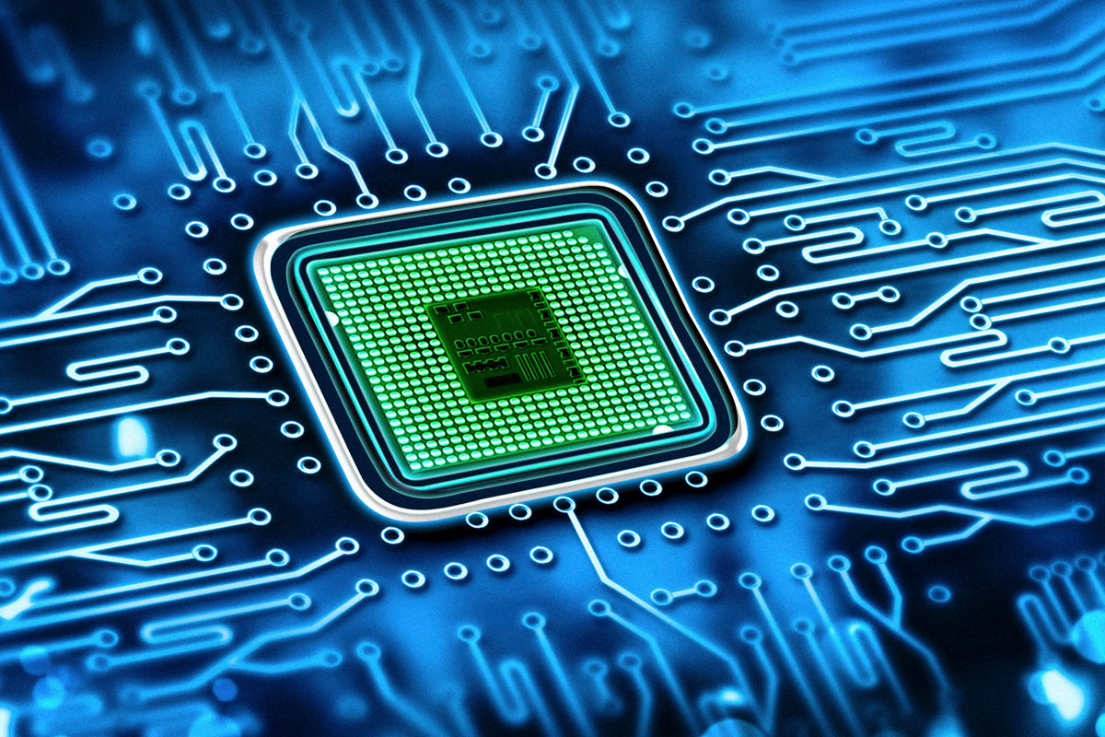
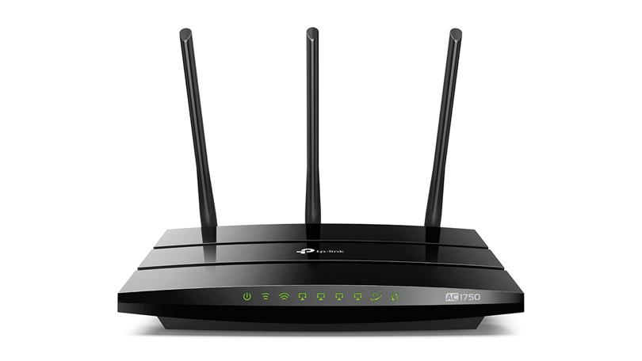
6.3) Network Routers & Switches (Jasjot)
6.3) Network Routers & Switches
What is a "Routing Table"?
It is a data table stored in a router or a networked computer that lists the routes to particular network destinations, and in some cases, metrics associated with those routes.
How are data packets sent through the internet between a client and a server?
Each packet carries the information that will help it get to its destination: the sender's IP address, the intended receiver's IP address, something that tells the network how many packets this e-mail message has been broken into and the number of each particular packet.
What special hardware & software is required for a network router / switch?
Hardware:
The Processor (CPU)
RAM.
NVRAM.
ROM.
Flash memory.
Software:
Interfaces
Internetwork Operating System (IOS)
RXBoot Image.
Networks
Home

Slide 30
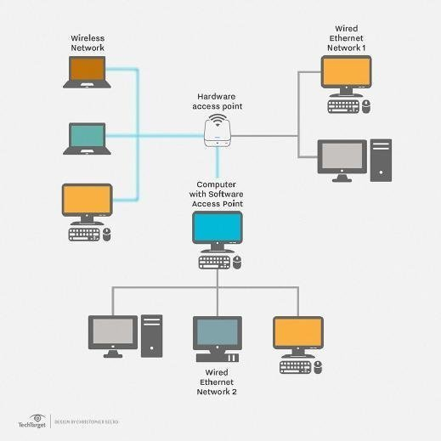
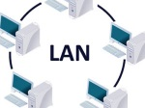
7) Types of Networks
Section Topics
Local Area Networks (LAN)
Wide Area Networks (WAN)
Virtual Private Networks (VPN)
LANs
Home

Slide 31
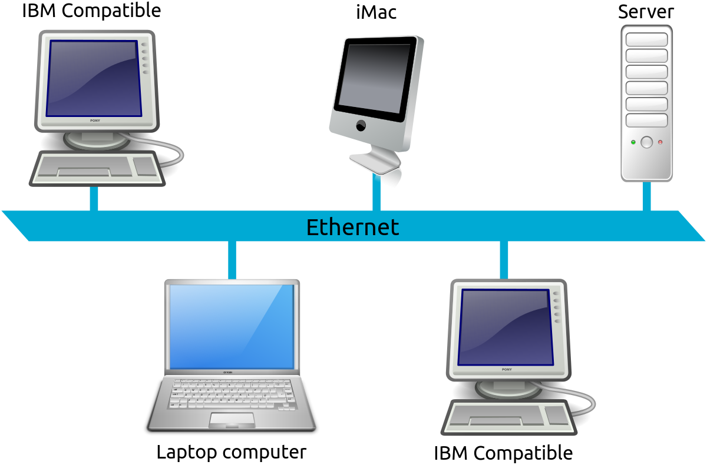
7.1) Local Area Networks (LAN)
What is a Local Area Network?
Local Area Network (LAN) is a group of computers and associated devices that share a common communications line or a articular wireless link and typically share the same resources of a single processor or server within a small area. Most of the time, the server has applications and data storage which is shared in common by multiple users. A local area network may serve as few as two or three users.
What is the purpose of a Local Area Network?
The purpose of LAN is to have two users connect and transfer data and support each other. These transfers are generally fast and the two or three users can use LAN to communicate with each other by chat or email.
What types of applications, servers, and computers are connected to a LAN?
Applications that are connected to LAN or have support for LAN could possibly be departmental applications such as spreadsheet and project management tools and for internet access. Servers and computers are also connected to LAN as the computer can implement client/server applications from any sort of computer and transfer data from there.
LANs
Home

Slide 32
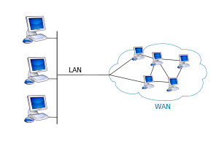
7.2) Wide Area Networks (WAN)
What is a Wide Area Network?
A wide area network is a network that exists over a large-scale geographical area. A WAN connects different smaller networks, including many local area networks (LANs) and many metro area networks This ensures that computers and users in one location can communicate with computers and users in other locations. WAN implementation can also be done either with the help of the public transmission system or a private network.
What is the purpose of a Wide Area Network?
The main purpose of Wide Area Networks is that it is used for connecting computers, that spans a wide geographical area. WANS are structured to link LAN connections and can also transmit data at slower speeds than LANs.
What types of applications, servers, and computers are connected to a WAN?
WAN can be connected together using the internet, leased lines or satellite links. Packet switching is the one of the most common types of establishing a WAN. In a packet switching method a digital network is established. In this method suitable data blocks are also created. These data blocks are then known as packets.
LANs
Home

Slide 33
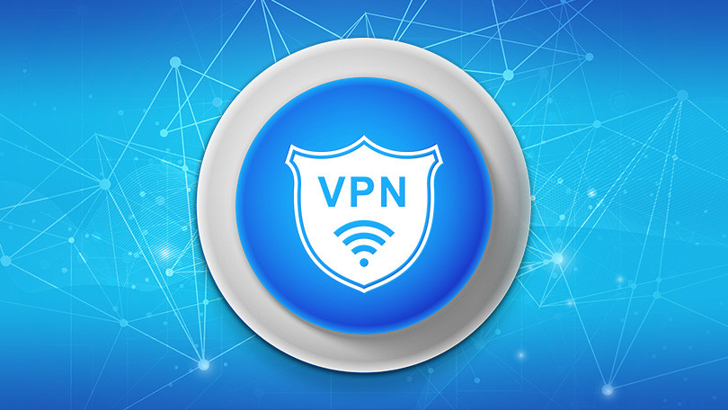
7.3) Virtual Private Networks (VPN)
What is a Virtual Private Network?
A Virtual private network (VPN) is an encrypted connection over the internet from a device within the network. The connection helps ensure that sensitive data is safely transmitted. VPN prevents any unauthorized people from eavesdropping on the traffic and allows the user to conduct work remotely. It is widely used in corporate environments.
How is a VPN different from a LAN / WAN?
The main difference between VPN and LAN/WAN is that VPN is invented for the purpose of encrypting data from a remote location and ensures that sensitive data is safely transmitted. WAN exists over a larger geographical area and connects to different smaller networks. LAN shares a common link between two or three devices and transfer bits of information.
How could you use a VPN to increase the security of services you use in the Internet?
A VPN can be used to enhance the security of your data as it is secured and encrypted, information can be accessed remotely from any other place, being able to share files for an extended period, VPN services allows you to access both web applications and websites in complete anonymity. Furthermore, there is also the ability to change IP address from another country, better performance as bandwidth and efficiency of the network can generally be increased once a VPN solution is implemented. Lastly, the cost is very low for a VPN.
LANs
Home

